Slide 1


Cardless Security System
Robert Goleberski
Matthew Santos
Zuwei Li

Slide 2
The Problem
Current Solutions:
-Iris, Voice, Fingerprint, Facial
Relatively easy to obtain identifiers
Many locks require an access token or key
Modern Biometric Locks are expensive

Slide 3

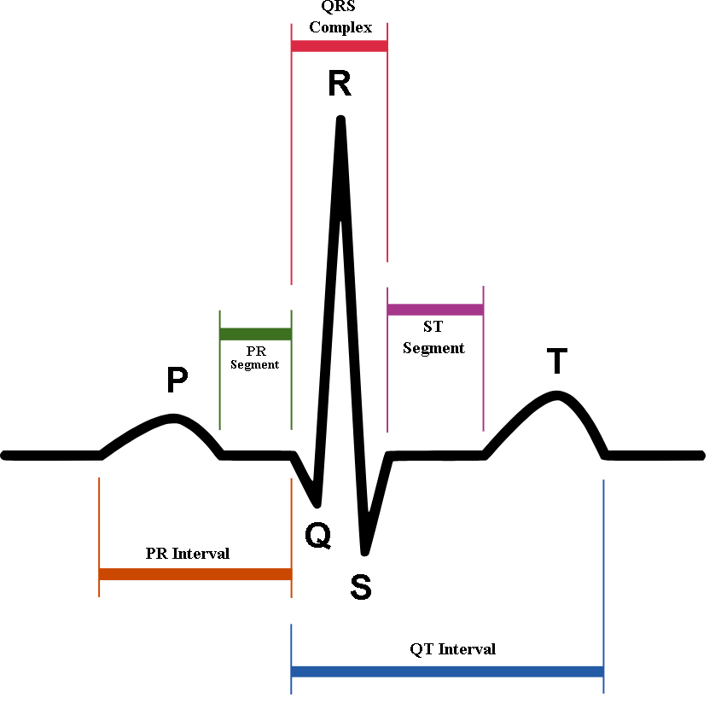
The Solution
Not easily stolen
Cheap to measure
Reliable?

Slide 4
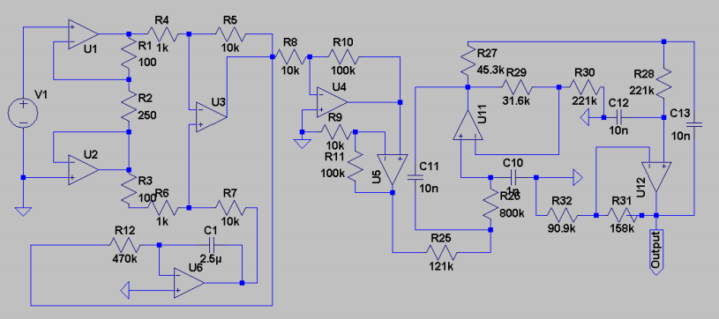
ECG Measurement
Analog front end ECG circuit

Slide 5
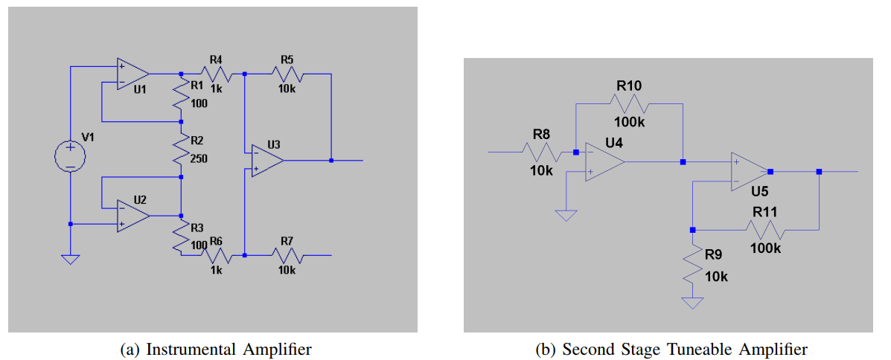
Amplification

Slide 6
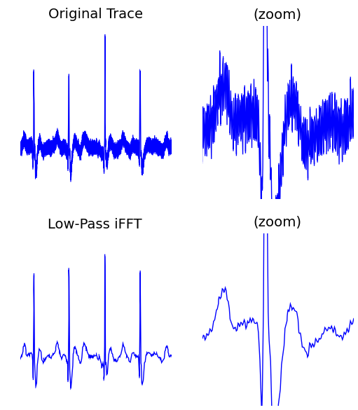
Noise Considerations
Baseline drift
Sixty hertz hum
High frequency noise
Micro muscle spasms

Slide 7
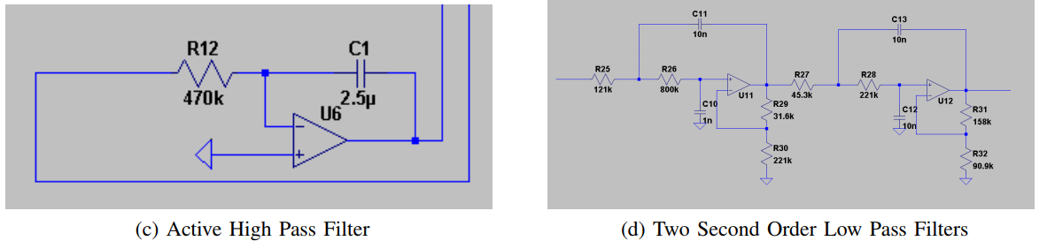
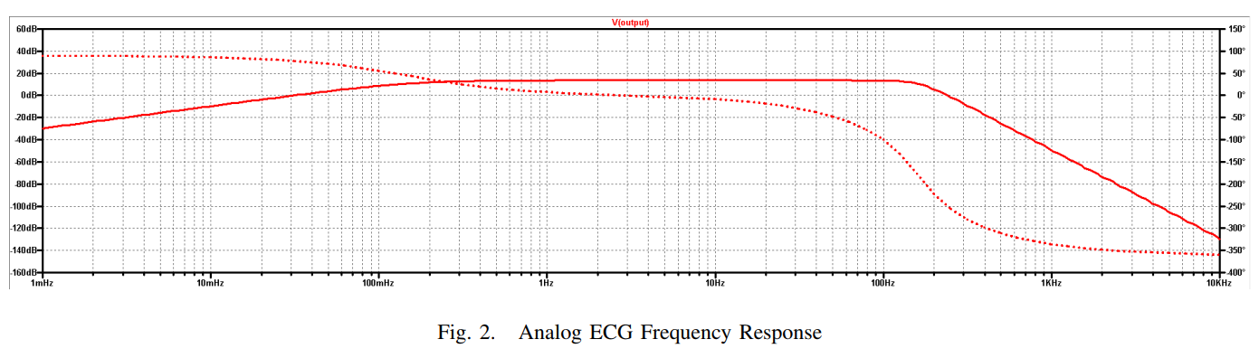
Filter

Slide 8
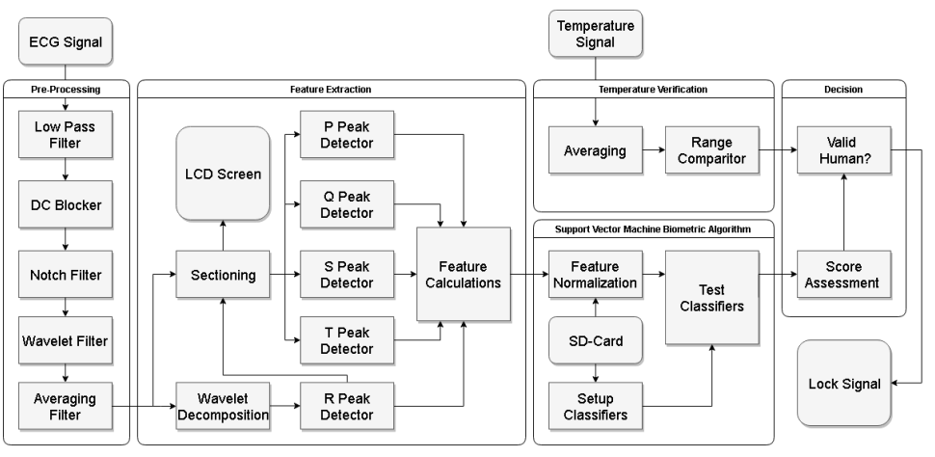
Biometric Algorithm

Slide 9
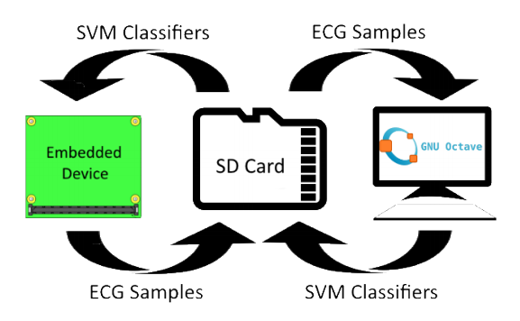
Offload Processing

Slide 10
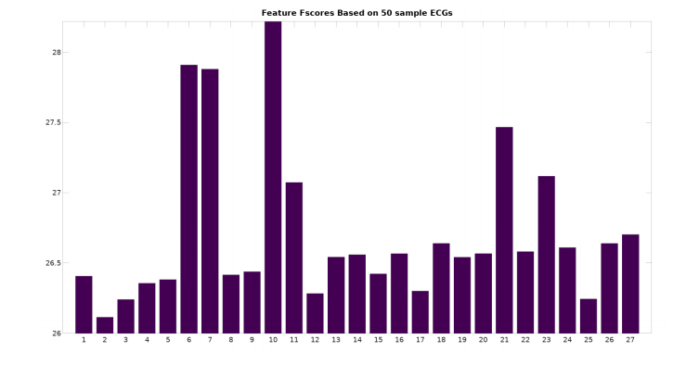
Results of Testing

Slide 11
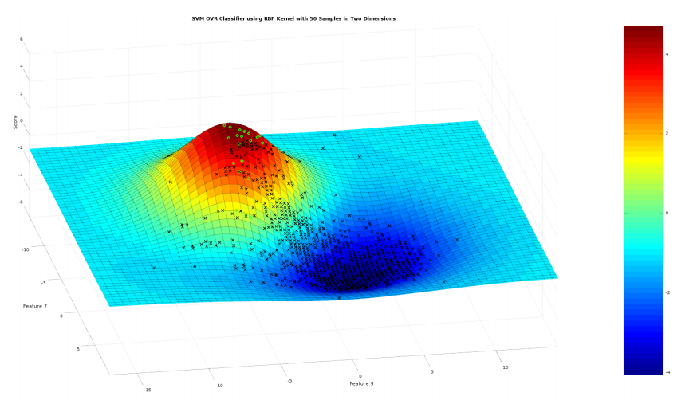
Results of Testing

Slide 12
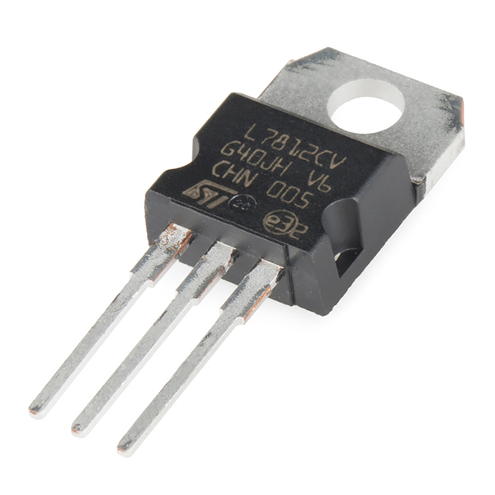
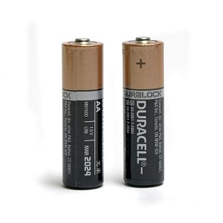
Powering the System
Powered through batteries
AA batteries due to size convenience
Regulator to protect the circuits supplied
Analog front end and Microprocessor

Slide 13
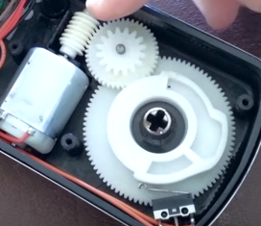
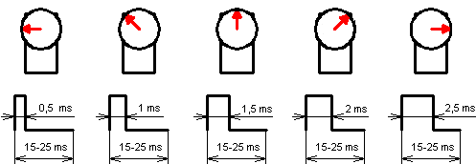
Motor Controller
Locking will take place with a deadbolt
Deadbolt to be moved by a servo motor
This motor is controlled through PWM

Slide 14
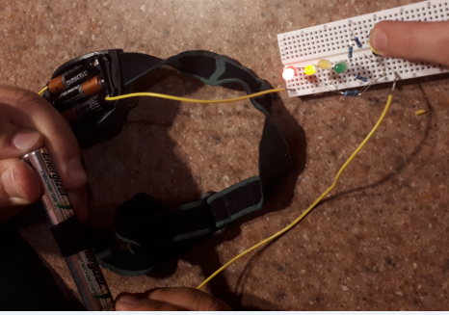
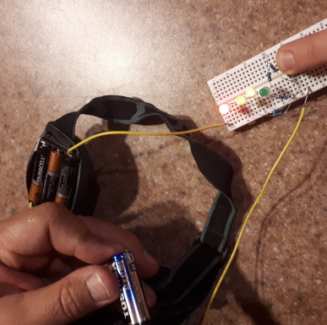
Voltage Indicator
Consists of LED’s and resistors
Push button to conserve power
Colour coded to indicate charge of batteries

Slide 15
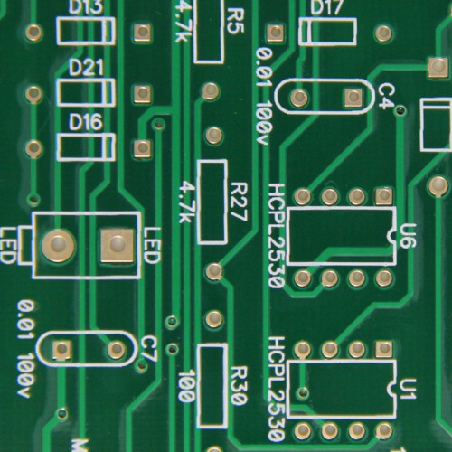
Next Steps
Select and order parts
Build and test circuits
Build prototype (PCB)
Debugging
Gather samples
Document findings

Slide 16
Summary
Completed:
Front end ECG processing
Bioalgorithm
Power charging and monitoring system
In Progress
Part selection
Testing and construction
Estimated time of completion : July 27th

Slide 17
References
http://www.milemarkerbrewing.com/heart-attacks-and-defibrillators/

